Slide 1
Predicting Heart Disease Risk Using a Classification Model
Nur Aisyah Athirah binti Hishamuddin

Slide 2
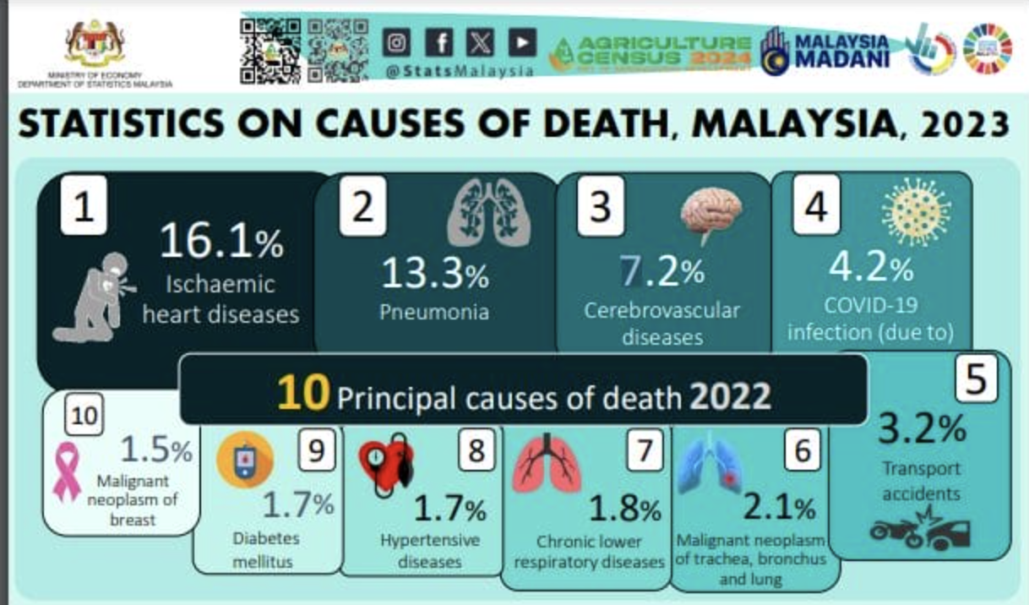
Introduction
Heart disease is the leading cause of death in many countries, including Malaysia, (Department of Statistics Malaysia [DOSM], 2023) where it remains a significant public health concern. Traditional methods of diagnosing heart disease often rely on extensive medical testing and patient history, which can be time-consuming and costly.
Early detection and accurate prediction of heart disease risk are crucial for implementing timely interventions and reducing mortality rates.
There is a need for a reliable, efficient, and accurate
predictive model that can assist healthcare
professionals in diagnosing heart disease,
ultimately improving patient outcomes and
optimizing healthcare resources.

Slide 3
Data and Modelling
Data: Indicators of Heart Disease sourced from Kaggle.com
How this model works?
The model obtained various health data from the dataset.
The model analyse the dataset to find patterns that might indicate whether someone is at risk of developing heart disease.
The result of analyzation is used to predict whether a new patient is at high risk for heart disease.

Slide 4
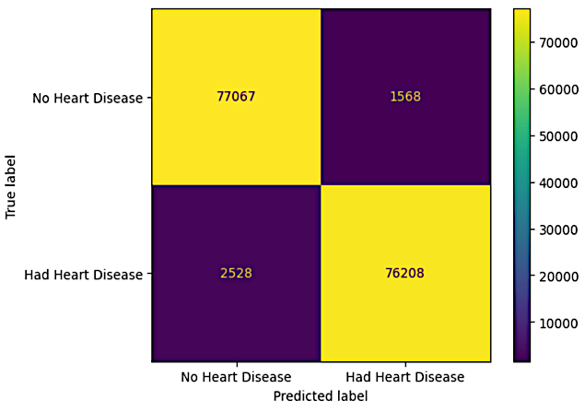
Model performance
Evaluation metrics | Score (%)
Accuracy | 97.40
Precision | 97.98
Recall (Sensitivity) | 96.79
F1-score | 97.38
ROC AUC | 99.60
Figure 1. Display for confusion matrix
True Negative | 77,067 patients really not have heart disease
True Positive | 76,208 really have heart disease
False Negative | 2,528 mistakenly predicted to not have heart disease (most harmful!!!)
False Positive | 1,568 mistakenly predicted to have disease
Table 1. Score for evaluation metrics

Slide 5
Implementation
Develop a user-friendly web-based platform or mobile applications
Start
Collect Health Data (age, lifestyle, medical history)
Analyze Patterns (study past records)
Input New Patient Data (new patient's health information)
Predict Risk (high or low risk for heart disease)
Provide Results (result shown to the doctors)
Take Actions (doctors decide preventative measures or treatments)
End

Slide 6
Conclusion
Limitations of this model : The model was trained on specific data. It might not work as well for people from different backgrounds or with different health characteristics (e.g.: What may be a significant risk factor for individuals in America might not be as relevant for those in Malaysia, due to common genetic variations and differing health profiles )
Improvements : Dataset must integrate more diverse features and recall need to be enhanced to reduce false negatives.

Slide 7
Thank you
Any question?

Slide 8
Reference
National Academies Press (US). (2010). Ischemic heart disease. Cardiovascular Disability - NCBI Bookshelf. https://www.ncbi.nlm.nih.gov/books/NBK209964/
Portal MyHEALTH. (2016, August 18). Coronary artery Disease - PORTAL MyHEALTH. PORTAL MyHEALTH. http://myhealth.moh.gov.my/en/coronary-artery-disease
Eecpadmin. (2024, May 14). The top causes of death in Malaysia 2023. EECP Centre Malaysia - Treatment for Heart, Stroke, and Neurodegenerative Diseases. https://www.eecpcentre.com/news/top-causes-of-death-in-malaysia-2023/
Indicators of heart Disease (2022 UPDATE). (2023, October 12). Kaggle. https://www.kaggle.com/datasets/kamilpytlak/personal-key-indicators-of-heart-disease/data?select=2022
Heart disease risk factors. (2024, May 15). Heart Disease. https://www.cdc.gov/heart-disease/risk-factors/?CDC_AAref_Val=https://www.cdc.gov/heartdisease/risk_factors.html

